Slide 1
Heat networks:
A toolkit to support advisers and caseworkers
Last Revised July 2026

Slide 2
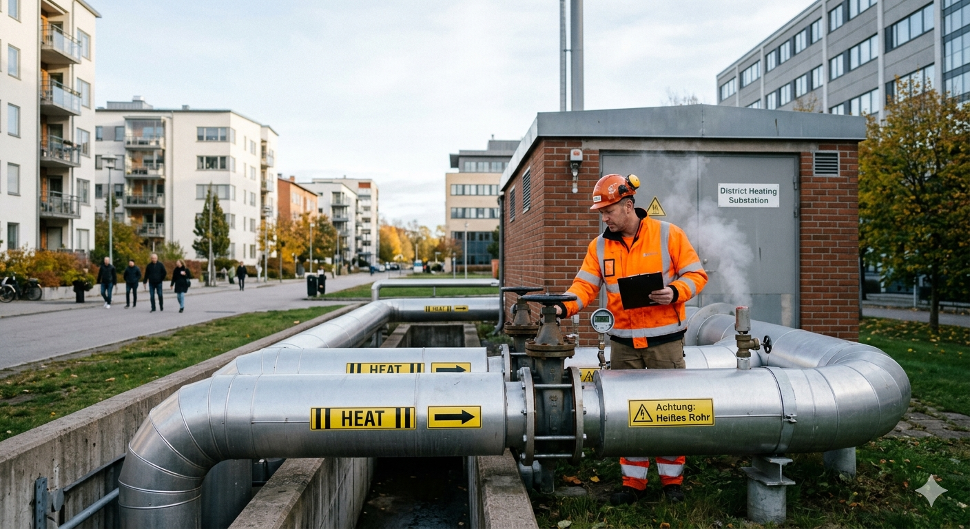
Contents
Introduction - Consumer Scotland
Introduction – Who this toolkit is for and what it includes
Understanding heat networks
Key challenges for consumers
Heat network regulation
Heat Networks Advice Service
Training and resources
1
2
3
4
5
6
7-9

Slide 3
Introduction - Consumer Scotland
The Act defines consumers as individuals and small businesses that purchase, use or receive in Scotland goods or services supplied by a business, profession, not for profit enterprise, or public body.
Our purpose is to improve outcomes for current and future consumers, and our strategic objectives are:
to enhance understanding and awareness of consumer issues by strengthening the evidence base
to serve the needs and aspirations of current and future consumers by inspiring and influencing the public, private and third sectors
to enable the active participation of consumers in a fairer economy by improving access to information and support
On April 1st 2025 Consumer Scotland became the statutory advocate for heat network consumers in Scotland.
As part of this new responsibility, Consumer Scotland is taking forward a programme of research looking into the issues and experiences heat network users face, using this evidence to advocate for better outcomes.
We formally represent consumers on industry and advisory groups, ensuring the consumer voice is heard at all stages of decision making.
Consumer Scotland has worked with advice bodies in Scotland to build heat network support into existing energy advice services:
Consumers have access to advice and support through energyadvice.scot from Advice Direct Scotland.
ADS can refer consumers in vulnerable circumstances to access additional support through the Extra Help Unit at Citizens Advice Scotland.
Consumer Scotland is the statutory body for consumers in Scotland. Established by the Consumer Scotland Act 2020, we are accountable to the Scottish Parliament.
1

Slide 4
Introduction
Who this toolkit is for and what it includes
Heat networks are a growing part of Scotland’s energy system, and advisers and caseworkers are increasingly likely to encounter consumers who rely on them for heating and hot water. While heat networks play an important role in decarbonising heat, they also present new and sometimes complex challenges for consumers.
This toolkit is designed to support advisers and caseworkers who provide assistance to households and small businesses using heat networks. Whether you are encountering heat network issues for the first time or are looking to build your knowledge of recent regulatory changes, this document provides a practical guide to understanding the system and supporting consumers effectively.
The toolkit explains how heat networks operate, outlines the types of issues consumers may face, and sets out the advice and support pathways available. It also provides links to guidance to support advisers on how to respond to common scenarios, including billing concerns, service interruptions, and complaints.
As the heat network sector continues to evolve, this toolkit should be used alongside up-to-date guidance and referral services to ensure consumers receive accurate and effective support.
This toolkit includes information on:
The statutory advice services available in Scotland
The resources available for caseworkers who provide advice and support to heat network consumers
Training and development available to upskill on heat networks
2

Slide 5
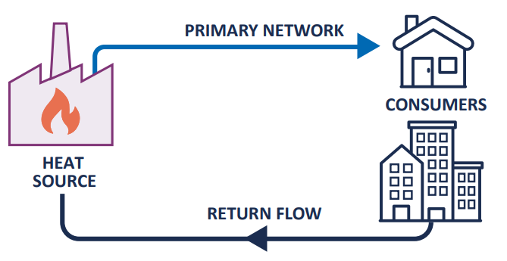
Understanding heat networks
There are currently 30,000 households who get their heating and hot water from heat networks in Scotland. The number of households on heat networks is expected to increase substantially over the next decade, as heat networks are a key part of efforts to decarbonise home heating and lower bills.
Heat networks supply heating and hot water from a central source to multiple homes or buildings. Instead of each property having its own boiler, heat is generated centrally and distributed through a network of insulated pipes.
There are different types of heat networks, including communal systems serving a single building and district networks serving multiple buildings or developments. Regardless of the type, the key feature is that consumers are connected to a shared system.
This shared infrastructure means that heat networks operate differently from traditional energy markets. In most cases, consumers cannot switch supplier, as the network is tied to the building or area. This makes heat networks a form of natural monopoly, where the consumer’s experience is heavily dependent on the performance and practices of a single provider.
Understanding this context is essential when supporting consumers, as many of the issues they face, particularly around pricing and service, stem from this lack of choice.
3

Slide 6
Key challenges for consumers
There are several structural challenges associated with heat networks that can affect consumer outcomes.
One of the most significant is the lack of supplier choice. As consumers are connected to a specific network and heat networks operate as natural monopolies, consumers cannot switch providers if they are dissatisfied with pricing or service. This places greater importance on effective regulation and strong consumer protections.
Billing and pricing can also be difficult to understand, particularly where charges include a combination of fixed and variable costs. Without clear information, consumers may struggle to assess whether they are being charged fairly.
Awareness of rights and available support is another key issue. As heat networks are relatively new for many consumers, there is often limited understanding of what protections are in place or how to raise concerns.
Vulnerable consumers may face additional challenges, particularly where heating and hot water are essential to health and wellbeing. Ensuring these consumers receive timely and appropriate support is a critical aspect of advisory work.
For more information on some of the key issues heat network consumers face, please refer to Consumer Scotland’s recently published Issues Paper.
In many cases, consumers are not aware that support is available or may not understand how to access it. Advisers therefore play a critical role in helping consumers navigate support systems and access appropriate assistance.
4

Slide 7

Heat network regulation
The new regulations introduce requirements relating to pricing transparency, billing standards, and complaints handling. They also include specific provisions to protect consumers in vulnerable circumstances.
However, this is a newly established framework, and it will take time for its full impact to be realised. Advisers should be aware that while standards have been set, some consumers may not yet experience immediate improvements in all areas.
The regulatory framework is expected to evolve over time as the market develops and further evidence becomes available. Therefore, keeping up to date with guidance and changes will be important for those providing consumer support.
In January 2026, a new regulatory framework for heat networks came into effect across Great Britain, with Ofgem appointed as the regulator. This represents a significant step forward in improving protections for consumers.
5

Slide 8


Heat Networks Advice Service
What help is available?
Advice Direct Scotland (ADS) helps households and small businesses access holistic advice and support to navigate the changing energy landscape.
Consumers on heat networks in Scotland have access to free, practical advice and support from ADS on:
Energy enquiries relating to heat networks
Understanding heat network complaints processes
Problems with energy bills
Additional support is available to customers in vulnerable circumstances. These customers will be referred by ADS to the Extra Help Unit at Citizens Advice Scotland.
The Extra Help Unit (EHU) at Citizens Advice Scotland is an established service with statutory responsibilities in the gas and electricity market. The EHU supports people and small businesses across Great Britain who are in vulnerable circumstances and require extra support to resolve their energy complaint.
Heat network consumers have access to independent dispute resolution through the Energy Ombudsman after 8 weeks or if the complaint reaches deadlock.
Where to find support?
Heat network customers should contact Advice Direct Scotland via:
Website and live chat: energyadvice.scot
By phone: 0808 196 8660
Email contact form: energyadvice.scot/email-us
6

Slide 9
Training and resources
Upskilling for heat network caseworkers
As the statutory advocate for heat network consumers in Scotland, Consumer Scotland wants to ensure that the advisers and caseworkers are equipped to provide consumers with the information, advice and support they need.
Consumer Scotland is working to develop a webinar series to support advisers and caseworkers that provide support to heat network consumers. The sessions are aimed at improving knowledge of:
Understanding heat networks - the session will focus on the technology that underpins heat networks, how this works and how consumers can interact with this.
Understanding the challenges and issues facing heat network consumers - the session will focus on the known issues and challenges that consumers can experience.
Understanding heat network regulation - the session will provide an introduction to regulation including what this means in practical terms for industry and for consumers.
Maximising the opportunity from heat networks - the session will provide another view of plans for the rollout of heat networks including the potential to tackle fuel poverty, decarbonise Scotland’s buildings and the opportunity to connect to sources of waste heat.
These sessions are expected to be delivered in Autumn 2026. If you are interested in attending any of these sessions, please contact heatnetworks@consumer.scot
7

Slide 10
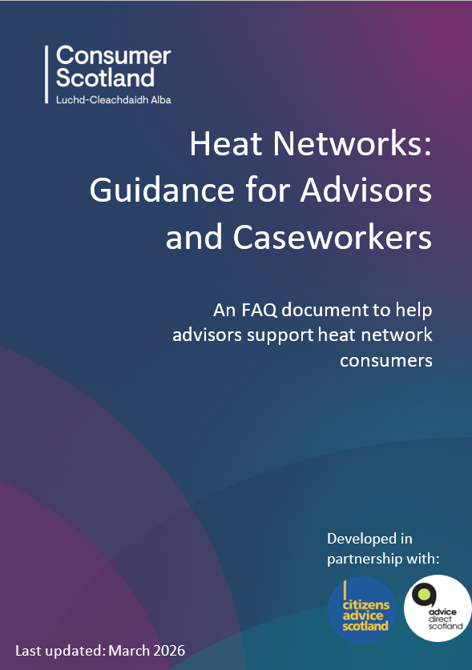

Training and resources
Heat networks are a rapidly evolving sector, and Consumer Scotland is firmly committed to developing a strong evidence base to facilitate the development of consumer-focused policy and advocacy work.
We have created key deliverables with information on up-to-date heat network consumer data, regulatory changes and statutory advice guidance.
Heat Network Regulation Guidance for Advisers and Caseworkers – Consumer Scotland has developed guidance to support advisers and caseworkers to understand what they need to know about recently introduced heat network regulation so that they can provide consumers with consistent, high-quality advice.
Consumer Scotland Consumer Challenges and Issues Paper – Consumer Scotland has published a review of recent evidence and literature setting out the challenges facing heat network consumers in Scotland.
A short, informative and accessible heat networks explainer video for consumers.
8

Slide 11
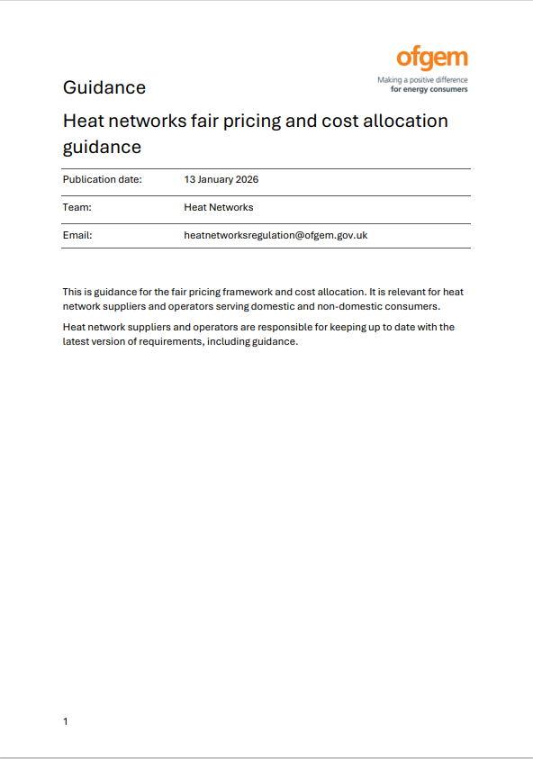
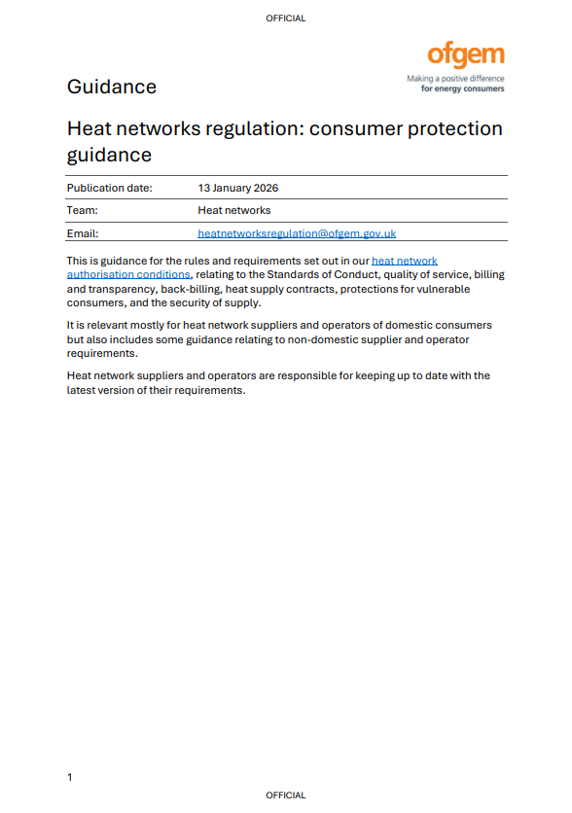
Training and resources
Ofgem guidance
As regulator of heat networks in Great Britain, Ofgem have produced a series of guidance documents on the different aspects of heat network regulation, such as fair pricing and consumer protection.
Heat networks regulation: registration: Guidance to help heat network operators and suppliers with deemed authorisation understand their obligation to register with Ofgem.
Heat networks regulation: fair pricing and cost allocation: Guidance on the fair pricing network and cost allocation for heat network suppliers and operators serving domestic and non-domestic consumers.
Heat networks regulation: consumer protection: Guidance for the consumer protection rules and requirements set out in heat network authorisation conditions.
Heat networks regulation: financial resilience: This guidance covers the following three authorisation conditions which heat networks are required to comply with.
Heat networks regulation: enforcement guidelines: Guidelines on how Ofgem may use their enforcement powers and tools in situations relating to breaches and infringements.
Heat networks regulation: penalty policy: Policy on financial penalties and consumer redress for businesses operating in the heat networks sector.
9

Slide 12
Contact: heatnetworks@consumer.scot

